Slide 1
Zero Emissions Transport Sector
The United States has set a goal to make half of all new passenger cars and light trucks sold in the U.S. in 2030 zero-emissions vehicles, and to build a network of 500,000 vehicle chargers. By 2040, a target of 100% of all new medium- and heavy-duty vehicles sold be zero-emission vehicles is targeted, with an interim 30% sales target for these vehicles in 2030.
https://www.transportation.gov/rural/ev#:~:text=The%20Federal%20Government%20has%20set,local%20and%20long%2Ddistance%20trips
https://www.whitehouse.gov/briefing-room/statements-releases/2023/04/12/fact-sheet-biden-harris-administration-proposes-new-standards-to-protect-public-health-that-will-save-consumers-money-and-increase-energy-security/

Slide 2
The Reference scenario
REF for the United States is a continuation of existing energy demand and supply trends with low realization of decarbonization measures.
On the demand side, energy efficiency and fuel efficiency continue to improve gradually in line with historical trends. In Buildings, natural gas remains available as a fuel. Electrification of the transport sector begins as electric vehicle sales increase, but without coordinated policy incentives and supporting infrastructure such as charging stations. The transport sector does not reach the stated goal of half of all new passenger car and light truck sales being zero emissions by 2030. The industry sector is assumed to gradually make improvements in energy efficiency and fuel switching.
In the power sector, fuel switching from coal to gas and renewables such as large-scale PV continues. Demonstration scale CCUS projects are included. Offshore wind does not expand rapidly due to assumed permitting constraints. The target of a net-zero power sector by 2035 is not realized due to limits in deploying CCS and co-firing with low-GHG hydrogen.
Production of oil and gas continues and serves domestic and international demand. Existing and under construction LNG projects are retained, while approved projects are assumed to become operational. For reference:
The Target scenario
In TGT, it is assumed that the goal to reach net-zero emissions by 2050 is achieved in part through reductions from fossil fuel combustion in the energy sector. Technology deployment and behavioral changes are necessary to achieve the target and are assumed to be feasible. Upstream and midstream fugitive methane emissions are also substantially reduced.
Demand-side energy efficiency and fuel efficiency improve at a higher rate than REF. In the buildings sector, electricity substantially replaces natural gas. The transport sector reaches the goal of half of all new passenger car and light truck sales being zero emissions by 2030 and 100% of all new medium- and heavy duty-vehicle sales by 2040.

Slide 3
Transport | Fleet remains mostly ICEs Fuel economy follows recent trends XX% of new passenger and light truck vehicle sales by 2030 XX% of new passenger and light truck vehicle sales by 2050 | 50% of new passenger and light trucks are EV by 2030 100% of new passenger and light trucks are EV by 2050 100% of all new medium- and heavy-duty vehicles sold in 2040 are zero emission (EV, hydrogen, biofuel)

Slide 4
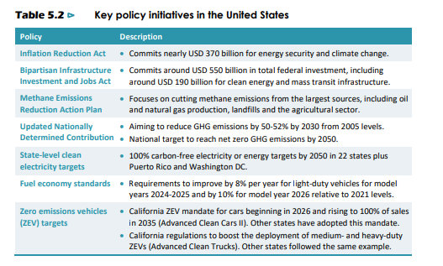
From IEA WEO2023
Fuel economy standards
• Requirements to improve by 8% per year for light-duty vehicles for model years 2024-2025 and by 10% for model year 2026 relative to 2021 levels. Zero emissions vehicles (ZEV) targets
• California ZEV mandate for cars beginning in 2026 and rising to 100% of sales in 2035 (Advanced Clean Cars II). Other states have adopted this mandate.
• California regulations to boost the deployment of medium- and heavy-duty ZEVs (Advanced Clean Trucks). Other states followed the same example.

Slide 5
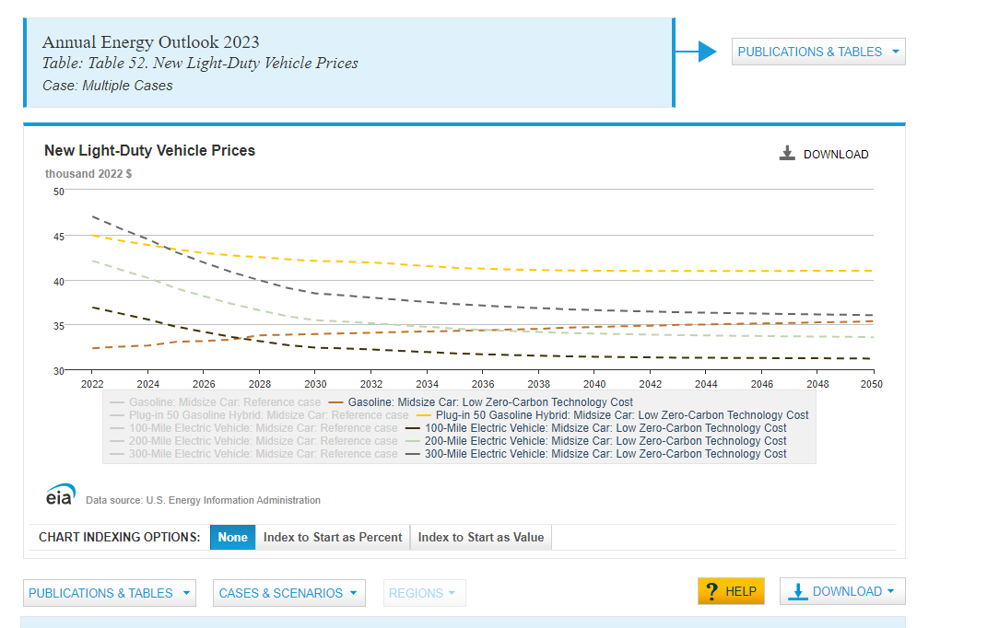
https://www.eia.gov/outlooks/aeo/data/browser/#/?id=114-AEO2023&region=0-0&cases=ref2023~lowZTC&start=2021&end=2050&f=A&linechart=~~ref2023-d020623a.6-114-AEO2023~lowZTC-d020623a.6-114-AEO2023~ref2023-d020623a.61-114-AEO2023~lowZTC-d020623a.61-114-AEO2023~ref2023-d020623a.171-114-AEO2023~lowZTC-d020623a.171-114-AEO2023~ref2023-d020623a.189-114-AEO2023~lowZTC-d020623a.189-114-AEO2023~ref2023-d020623a.207-114-AEO2023~lowZTC-d020623a.207-114-AEO2023&sourcekey=1

Slide 6
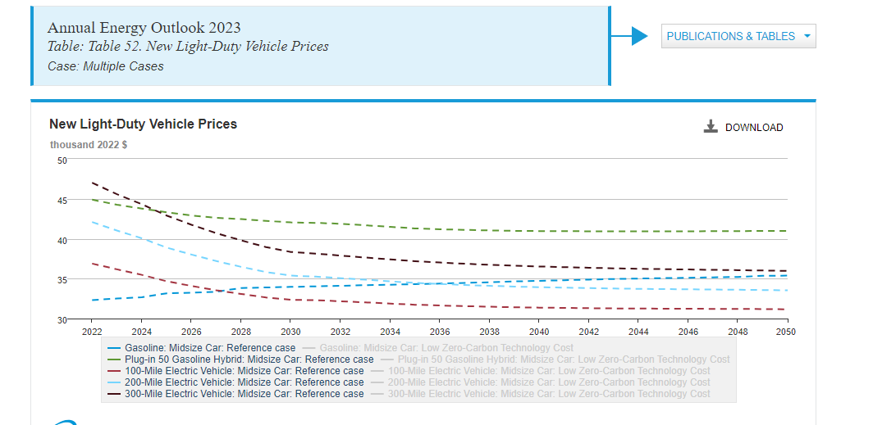

Slide 7
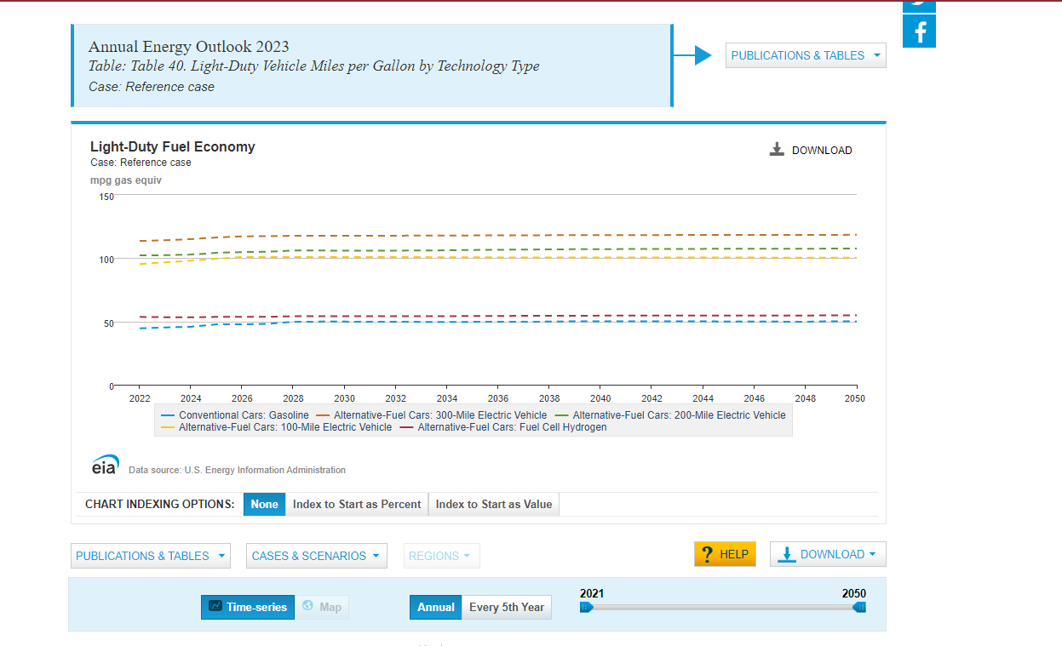
https://www.eia.gov/outlooks/aeo/data/browser/#/?id=50-AEO2023&region=0-0&cases=ref2023&start=2021&end=2050&f=A&linechart=ref2023-d020623a.4-50-AEO2023~ref2023-d020623a.11-50-AEO2023~ref2023-d020623a.10-50-AEO2023~ref2023-d020623a.9-50-AEO2023~ref2023-d020623a.21-50-AEO2023&ctype=linechart&sourcekey=1

Slide 8
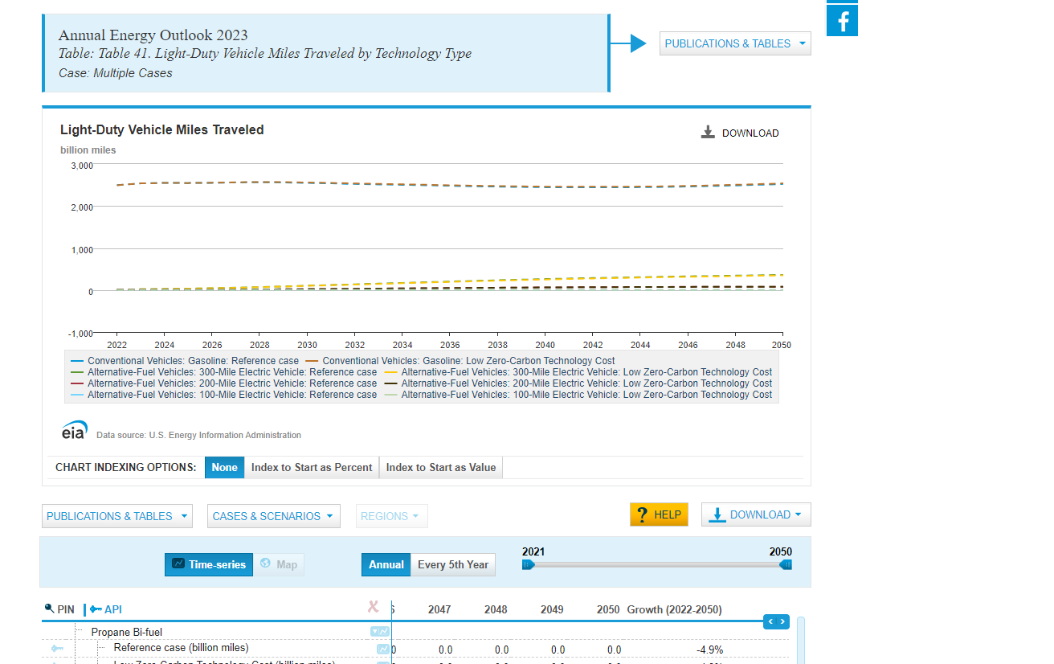

Slide 9
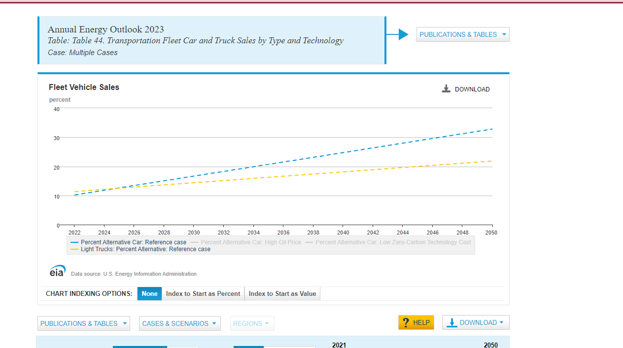
Note that the other scenarios showed basically the same results.like within a %

Slide 10
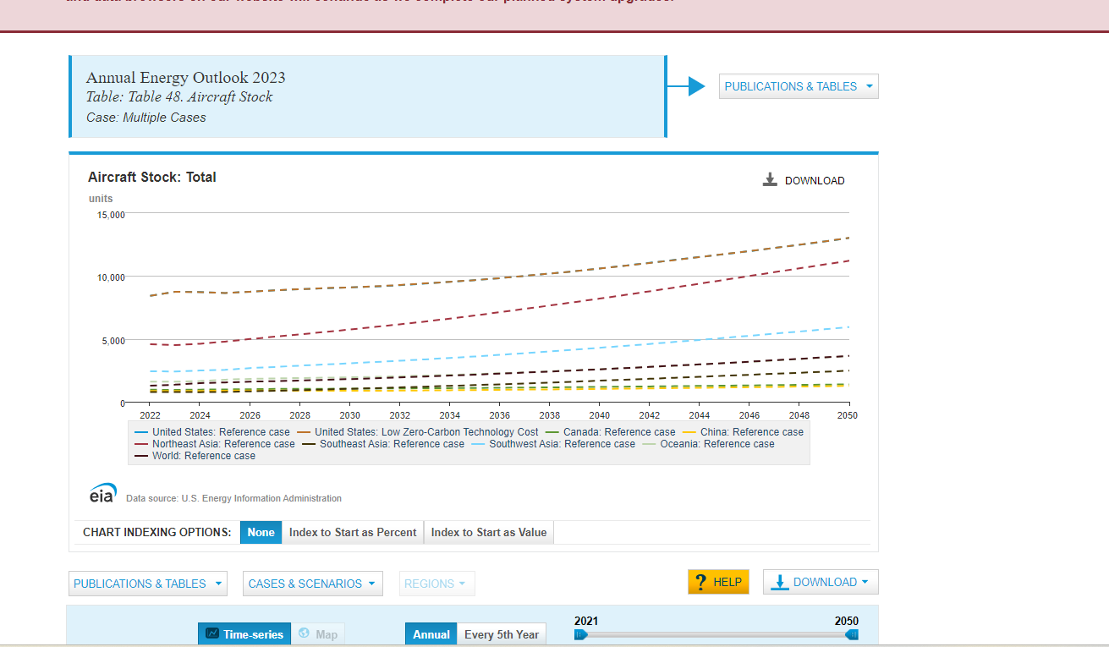
Top line is usa btw. Also world is near 2500 and probably not all of world but ‘other countries’

